Slide 1
Presented by Group1
Mr. Bun Sarem
Mr. Teth Sophany
Miss. Tim Lika
Mrs. Sok Phally

Slide 2
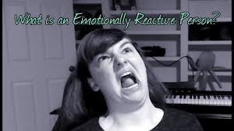
Chapter 7:Being Proactive
1) Proactive ( Positive people> lead their lives happily, persistently
2) Reactive : ( complain, excuse, blame , cannot control their own feeling or situation.

Slide 4
Application:( Are you proactive or reactive? )
1) facing challenges, always complain
2) easily give up, rather than get up
3) distracted by litter voice
4) learn from the failure
5) mistake is your real teacher
6) Never give up

